Slide 1
Materials Modelling and Simulation
Panos Grammatikopoulos
10 September 2016

Slide 2







1. Brief Introduction to Materials Modelling
La trahison des images
René Magritte
1

Slide 3

1. Brief Introduction to Materials Modelling
2

Slide 4

What is a model?
1. Brief Introduction to Materials Modelling
3

Slide 5
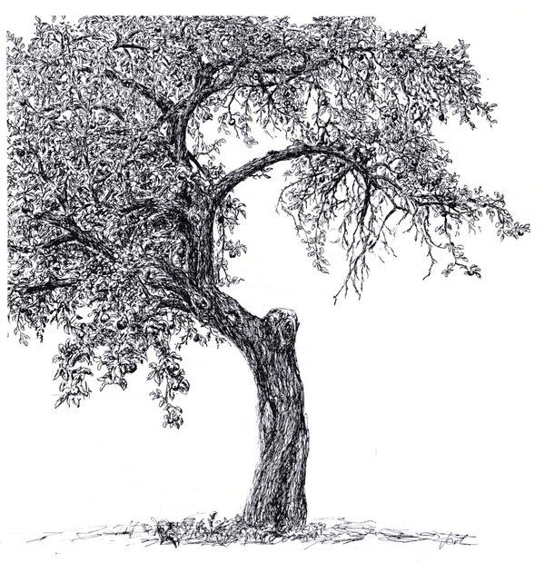

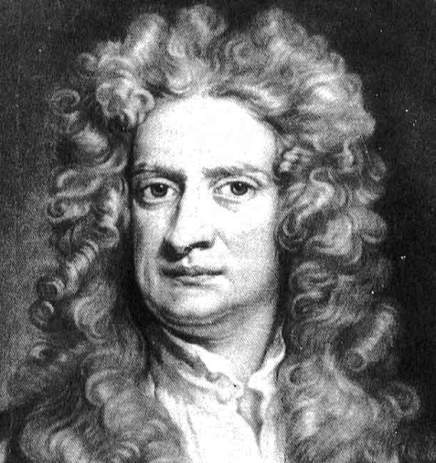
What is a model?
1. Brief Introduction to Materials Modelling
3

Slide 6
What is a model?
1. Brief Introduction to Materials Modelling
3

Slide 7
What is a model?
F=ma
1. Brief Introduction to Materials Modelling
3

Slide 8
What is a model?
model
1. Brief Introduction to Materials Modelling
3

Slide 9
What makes a good model?
1. Brief Introduction to Materials Modelling
4

Slide 10


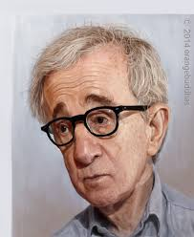
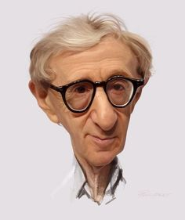




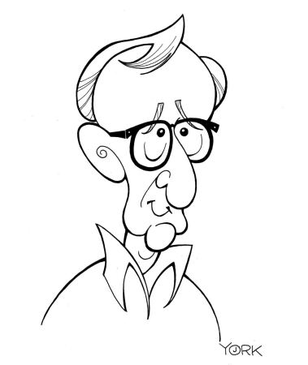





1. Brief Introduction to Materials Modelling
5

Slide 11
What makes a good model?
1. It should be simple
2. It should reproduce all the interesting behaviour of the system
1. Brief Introduction to Materials Modelling
6

Slide 12
What makes a good model?
Energy
parabola
r
interatomic
distance
Lennard-Jones potential
1. Brief Introduction to Materials Modelling
7

Slide 13
What makes a good model?
1. It should be simple
2. It should reproduce all the interesting behaviour of the system
2. It should be able to predict the evolution of the system satisfactorily
1. Brief Introduction to Materials Modelling
8

Slide 14

1. Brief Introduction to Materials Modelling
9

Slide 15
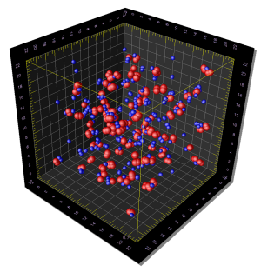

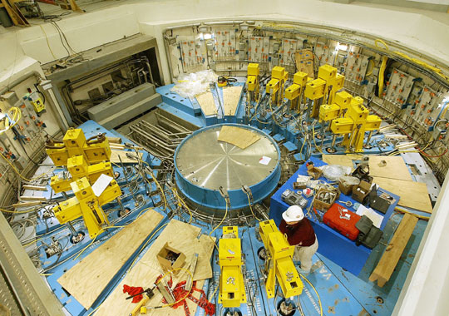

Why computer modelling?
Theory
Experiment
Computer Modelling
1. Brief Introduction to Materials Modelling
10

Slide 16
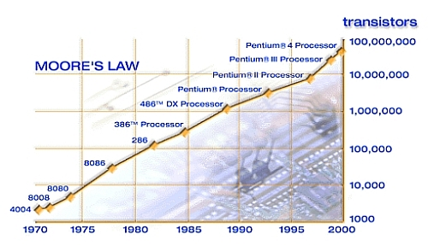
Why computer modelling?
1. Brief Introduction to Materials Modelling
11

Slide 17
Why do we need modelling?
1. Reduce experimental costs
2. Simulate extreme environments
3. Gain resolution beyond experimental reach
1. Brief Introduction to Materials Modelling
12

Slide 18
What do we need materials modelling?
To understand materials properties and phenomena
and design better materials for targeted applications
1. Brief Introduction to Materials Modelling
13

Slide 19
What are the necessary steps
to set up a materials simulation?
1. Define what to simulate
2. Make model system
3. Select relevant rules => method
4. Select code
5. Run code - obtain results
6. Analyse results - compare with theory/experiments
1. Brief Introduction to Materials Modelling
14

Slide 20
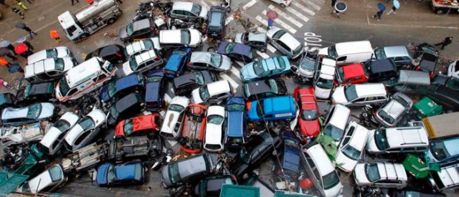

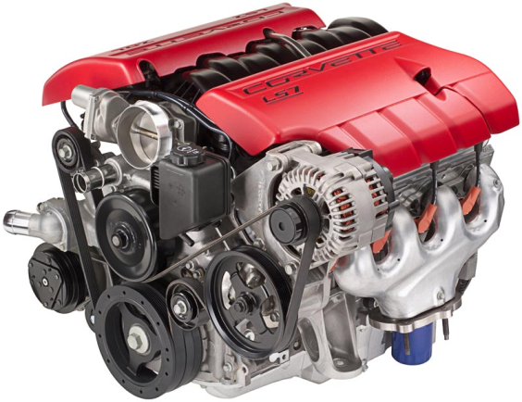
Important considerations
or
1. Brief Introduction to Materials Modelling
15

Slide 21

Important considerations
speed
accuracy
1. Brief Introduction to Materials Modelling
16

Slide 22
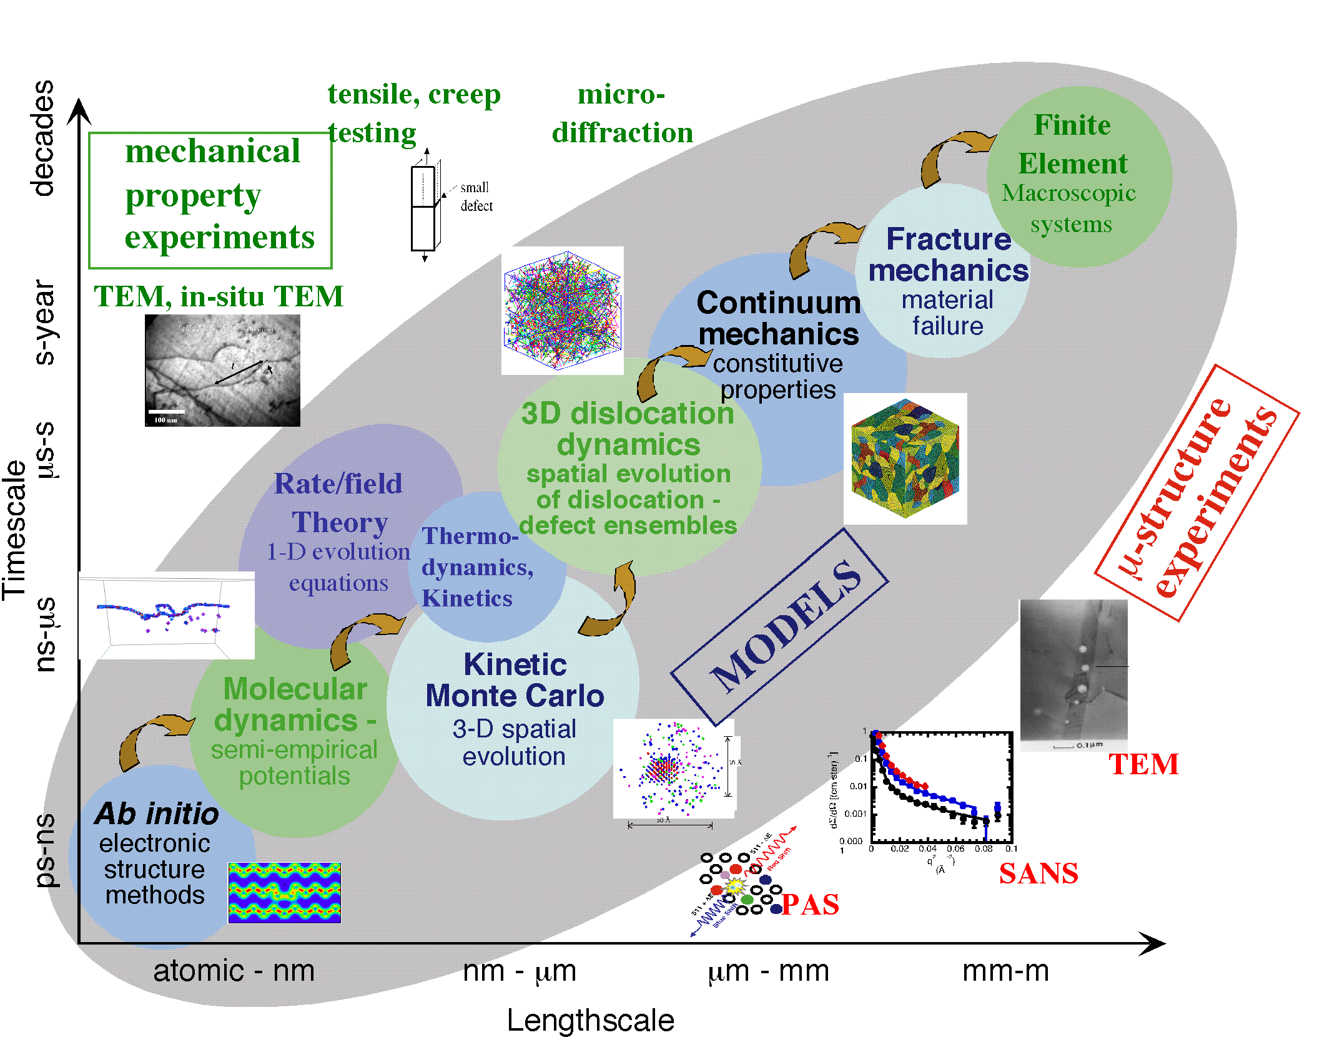
What are materials modelling methods?
1. Brief Introduction to Materials Modelling
17

